Slide 1
PH 508: Spacecraft systems
Thermal balance and control.

Slide 2
Spacecraft thermal balance and control: I
Introduction [See F&S, Chapter 11]
We will look at how a spacecraft gets heated
How it might dissipate/generate heat
The reasons why you want a temperature stable environment within the spacecraft.
Understanding the thermal balance is CRITICAL to stable operation of a spacecraft.

Slide 3
Spacecraft thermal balance and control: II
Object in space (planets/satellites) have a temperature. Q: Why?
Sources of heat:
Sun
Nearby objects – both radiate and reflect heat onto our object of interest.
Internal heating – planetary core, radioactive decay, batteries, etc.
Heat loss via radiation only (heat can be conducted within the object, but can only escape via radiation).

Slide 4
Spacecraft thermal balance and control: III
To calculate the heat input/output into our object (lets call it a Spacecraft) need to construct a ‘balance equilbrium equation’.
First: what are the main sources of heat?
For the inner solar system this will be the Sun, but the heat energy received by our Spacecraft depends on:
Distance from Sun
The cross-sectional area of the Spacecraft perpendicular to the Sun’s direction

Slide 5
Spacecraft thermal balance and control: IV
At 1 AU solar constant is 1378 Watts m⁻² (generally accepted standard value).
Varies with 1/(distance from sun)²
Consider the Sun as a point source, so just need distance, r.
Cross-sectional area we know for our Spacecraft (or any given object).

Slide 6
Spacecraft thermal balance and control:V
The radiation incident on our Spacecraft can be absorbed, reflected and reradiated into space.
So, a body orbiting the Earth undergoes:
Heat input:
Direct heat from Sun
Heat from Sun reflected from nearby bodies (dominated by the Earth in Earth orbit).
Heat radiated from nearby bodies (again, dominated by the Earth)

Slide 7
Spacecraft thermal balance and control:VI
Heat output
Solar energy reflected from body
Other incident energy from other sources is reflected
Heat due to its own temperature is radiated (any body above 0K radiates)
Internal sources
Any internal power generation (power in electronics, heaters, motors etc.).

Slide 8
Spacecraft thermal balance and control:VII
Key ideas
Albedo – fraction of incident energy that is reflected
Absorptance – fraction of energy absorbed divided by incident energy
Emissivity (emittance) – a blackbody at temperature T radiates a predictable amount of heat. A real body emits less (no such thing as a perfect blackbody).
Emissivity, ε, = real emission/blackbody emission

Slide 9
Spacecraft thermal balance and control:VIII
Need to consider operational temperature ranges of spacecraft components. Components outside these ranges can fail (generally bad).
Electronic equipment (operating) | -10 to +40° C
Microprocessors | -5 to +40° C
Solid state diodes | -60 to +95° C
Batteries | -5 to +35° C
Solar cells | -60 to +55° C
Fuel (e.g. hydrazine) | +9 to +40° C
infra-red detectors | -200 to -80° C
Bearing mechanisms | -45 to +65° C
Structures | -45 to +65° C

Slide 10
Spacecraft thermal balance and control:IX
How to stay cool?
Want as high an albedo as possible to reflect incident radiation
Want as low an absorptance as possible
Want high emissivity to radiate any heat away as efficiently as possible

Slide 11
Spacecraft thermal balance and control:X
Balance equation for Spacecraft equilibrium temperature is thus constructed:
Heat radiated from space =
Direct solar input + reflected solar input +Heat radiated from Earth (or nearby body)
+Internal heat generation
We will start to quantify these in a minute...

Slide 12
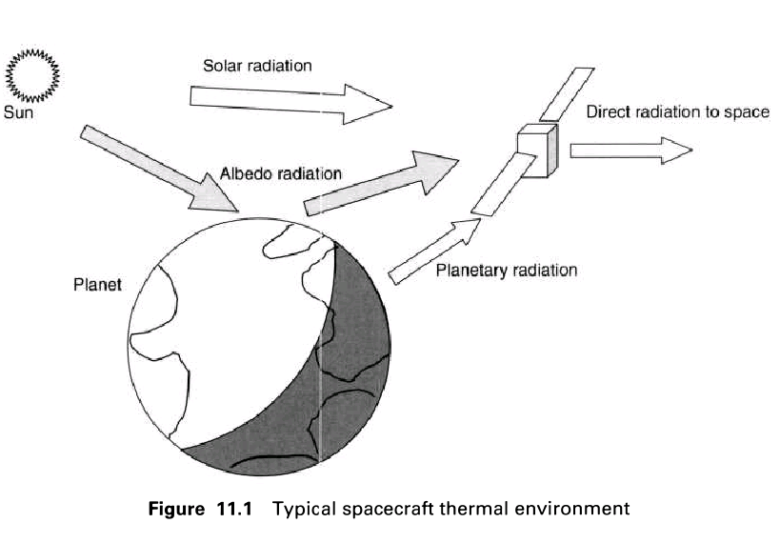
Spacecraft thermal balance and control:XI

Slide 13
Spacecraft thermal balance and control:XII
Heat radiated into space, J, from our Spacecraft. Assume:
Spacecraft is at a temperature, T, and radiates like a blackbody (σT⁴ W m⁻² , σ = Stefan’s constant = 5.670 x 10⁻⁸ J s⁻¹ m⁻² K⁻⁴)
It radiates from it’s entire surface area, A_{SC} – we will ignore the small effect of reabsorption of radiation as our Spacecraft is probably not a regular solid.
Has an emissivity of ε.
Therefore:
J = A_{SC}εσ T⁴

Slide 14
Spacecraft thermal balance and control:XIII
Now we start to quantify the other components.
Direct solar input, need:
J_{S}, the solar radiation intensity (ie., the solar constant at 1 AU for our Earth orbiting spacecraft).
A’_{S} the cross-section area of our spacecraft as seen from the Sun (A’_{S} ≠ A_{SC}!)
The absorbtivity, α, of our spacecraft for solar radiation (how efficient our spacecraft is at absorbing this energy)
Direct solar input = A’_{S} α J_{S}

Slide 15
Spacecraft thermal balance and control:XIV
Reflected solar input. Need:
J_{S} – the solar constant at our nearby body.
A’_{P} the cross-sectional area of the spacecraft seen from the planet
Asorbtivity, α, for spacecraft of solar radiation
The albedo of the planet, and what fraction, a, of that albedo is being seen by the spacecraft (function of altitude, orbital position etc.)
Define: J_{a} = albedo of planet x J_{S} x a
Reflected solar input = A’_{p} α J_{a}

Slide 16
Spacecraft thermal balance and control:XV
Heat radiated from Earth (nearby body) onto spacecraft. Need:
J_{p} = planet’s own radiation intensity
F₁₂, a viewing factor between the two bodies. Planet is not a point source at this distance.
A’_{P} cross-sectional area of spacecraft seen from the planet.
Emissivity, ε, of spacecraft
Heat radiated from Earth onto spacecraft= A’_{P} ε F₁₂ J_{P}
Q: Why ε and not α? α is wavelength (i.e., temperature) dependent. Planet is cooler than Sun and at low temperature α = ε)
Spacecraft internally generated heat = Q

Slide 17
Spacecraft thermal balance and control:XVI
So, putting it all together...
Divide by A_{SC}ε (and tidy) to get:
Therefore α/ε term is clearly important.

Slide 18
Spacecraft thermal balance and control:XVII
Of the other terms, J_{S}, J_{a}, J_{P} and Q are critical in determining spacecraft temperature.
Q: How can we control T? (for a given spacecraft).
In a fixed orbit J_{S}, J_{a}, J_{P} are all fixed.
Could control Q
Could control α/ε (simply paint it!)
So select α/ε when making spacecraft. Table on next slide gives some values of α/ε.

Slide 19
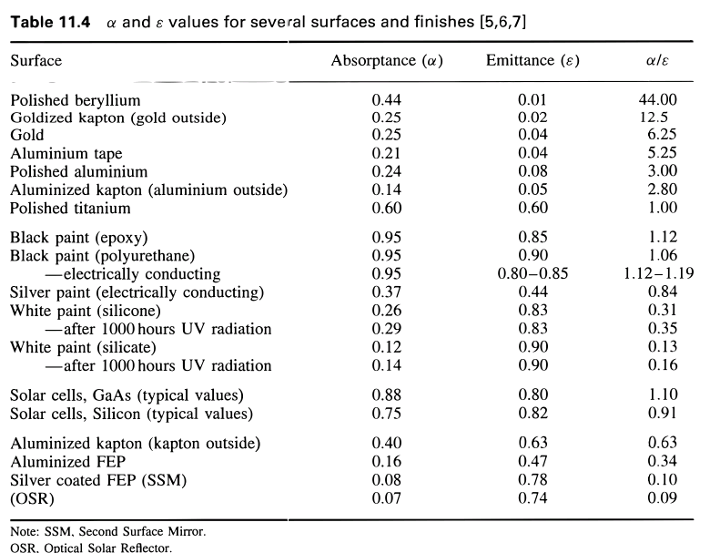
Spacecraft thermal balance and control:XVIII

Slide 20
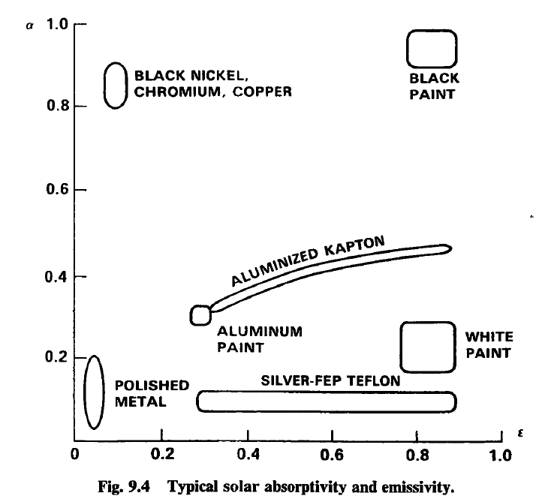
Spacecraft thermal balance and control:XIX

Slide 21
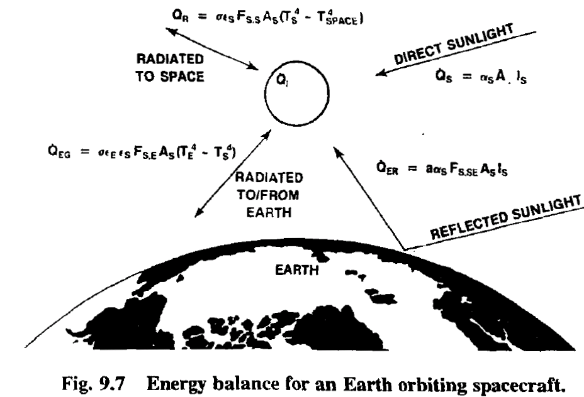
Spacecraft thermal balance and control:XX

Slide 22
Spacecraft thermal balance and control:XXI
Comment: All this assumes a uniform spherical spacecraft with passive heat control.
Some components need different temperature ranges (are more sensitive to temperature) so active cooling via refrigeration, radiators probably required for real-life applications.

